Slide 1
Faculty Senate Meeting
January 26, 2023

Slide 2
Meeting procedure
Only Senators may debate motions
Only Senators can vote
If you are not a Senator, or a proxy, you cannot vote or debate
Do not speak over someone, or out of order
Raise your hand to speak
The President may call on you and then you will have the floor
Unless you have been recognized (been told you have the floor), you may not speak

Slide 3
Meeting Minutes
We will be using Robert's Rules to guide our recording of minutes.
Robert's Rules of Order say that meeting minutes are simply a summary of what happened at the meeting.
They are not a play by play of everything that happened or what members said.
If needed, Faculty Senators may request access to the audio recording of the meeting. Please email facsenate@mst.edu with justification.

Slide 4
Agenda
Call to Order and Roll Call
D. Westenberg, Secretary

Slide 5
Agenda
Approval of Minutes
November 10, 2022

Slide 6
Agenda
III. President’s Report
K. Sheppard

Slide 7
Announcements and Things to watch for
Senate Bill 473: ending special status
Senate Bill 410: “Do no harm”
Senate Bill 42: Critical Race Theory bill
Board of Curators at S&T, April 20th
By laws should be discussed then

Slide 8
Campus Matters
Faculty Ombudsperson
Provides confidential and informal assistance to faculty, answers faculty questions, and assists in the resolution of concerns
Deadline EOB Feb 13^{th.} See: advance.mst.edu/programs
Contact Kate Drowne with questions
Remington R. Williams award: https://www.umsystem.edu/ums/aa/outstanding-student-leader-year-awards
February 3rd deadline

Slide 9
Campus Matters
Winter work
It’s a system policy but we encourage compassionate accommodations, common sense, and communication
Public Occasions will henceforth give informational reports rather than bring events for approval.
By-laws: D.6.m. “This committee makes general plans for University-sponsored assemblies, programs and public occasions…”
Shared governance
Student feedback on end of course evals

Slide 10
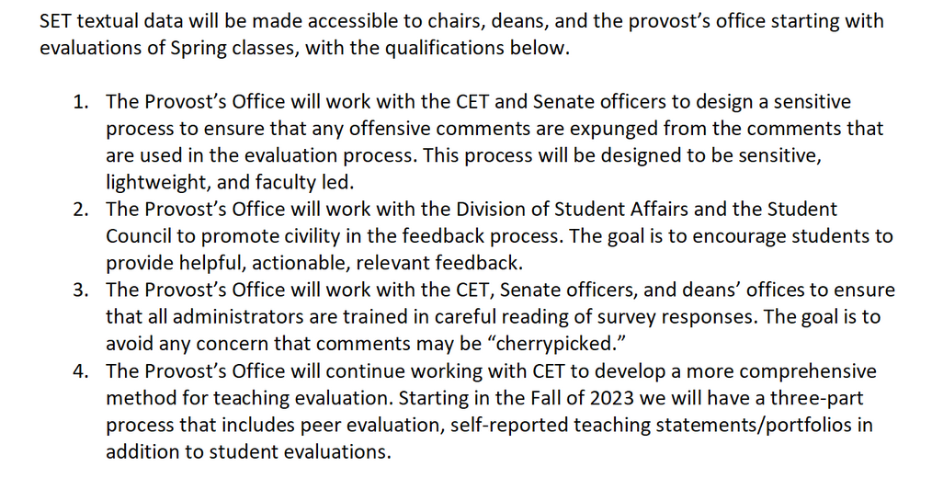

Slide 11
Spring Semester Focus
Enrollment and retention
Yield Campaigns
Bio X
Online programs
Faculty searches in progress
CASE - 10
CEC - 26
Kummer - 4

Slide 12
President Mun Choi Visit with FS Officers
Tuesday, January 31, 8am
Issues? Comments? Concerns?
Anonymous form (you will have to sign in, but we aren’t collecting email addresses)
https://forms.gle/Tn49zhRCR66oc8Rb7

Slide 13
Questions?

Slide 14
Agenda
IV. Campus Reports
A. Staff Council
M. Fowler

Slide 15
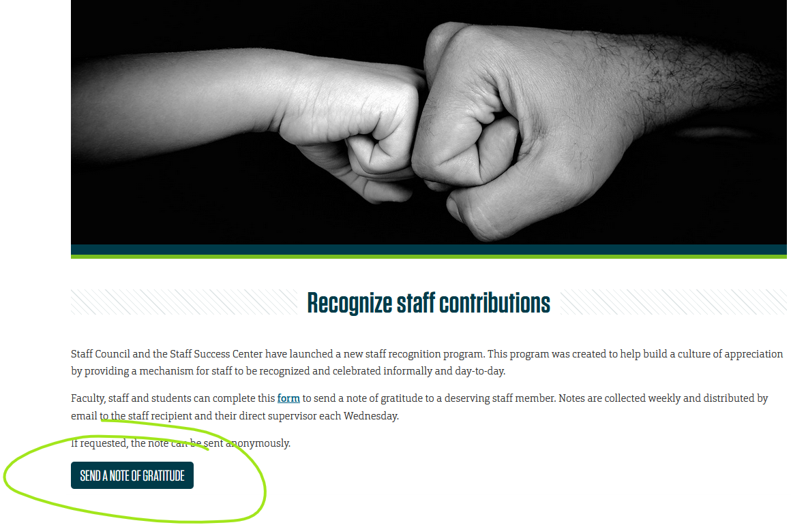
Staff Council
Employee Recognition Program Launch
First monthly newsletter went out to Faculty and Staff on January 18th. Mentioned launch of new employee recognition program. https://staffcouncil.mst.edu/staffsuccesscenter/recognition/

Slide 16
Agenda
IV. Campus Reports
B. Student Council
W. Retzlaff

Slide 17
Election Day Leniency Policy
Preparing to make a motion for February 16th
On all National Election Days, teachers exercise a leniency policy
A policy similar to that of the Career fair
Please reach out to me to provide any help on what would look best

Slide 18
Agenda
IV. Campus Reports
C. Council of Graduate Students
M. Twarakavi
(No report)

Slide 19
Agenda
V. Special Topic
Undergraduate Education
D. Reardon

Slide 20
Student Support Initiatives
Office of Undergraduate Education
Advising Center
Experiential Learning Office
Kummer Student Design Center
LEAD--[L]earning [E]nhancement [A]cross [D]isciplines
Student Success Center
Student Veterans Resource Center
Writing Center

Slide 21
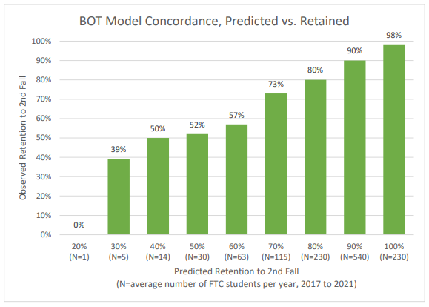
52/
113
5
Fall 2021 Cohort:
1011/1180 = 86.0%
92% = 1086/1180
+75
1
61%
7
14
27
31
46
54
3
225
486
184
84
16
36
7
Five Year Average:
1040/1228 = 84.7%
92% = 1130/1228
+90
2

Slide 22
Strategy #1
…Cornerstone Peers Scholarship & Support Program
Cornerstone: the first stone set; all other stones will be set in reference to this stone, thus determining the position of the entire structure
Modeled after the Kessler Scholars Program at U. Michigan, but expanded to the highest risk ~120 incoming FTC students; not exclusively First-Gen students like Kessler
Funding for first year pilot is coming from UE thanks in part to Kummer Institute Student Success funding
WHO: Mike Pleimann WHEN: full implementation for 40%+ risk
students (120) Fall 2023

Slide 23
Strategy #2
…Summer Scholars Program
A ten-week research-intensive summer experience
Selection will prioritize First-Generation and URM students
Modeled after the NSF Undergraduate Research Experience but with an academic component requiring the student to take one summer course, which opens course pathways and decreases time to graduation
Creates a pipeline encouraging students to consider graduate education
Funding for 10 students in the program's first year is coming from UE thanks in part to Kummer Institute Student Success funding
WHO: Dedie Wilson WHEN: pilot for 10 students in Summer 2023
possible expansion in Summer 2024

Slide 24
Agenda
VI. Reports of Standing Committees
A. Campus Curricula P. DeWitt

Slide 25
Campus Curricula Committee Report
8 December 2022
CCC Meeting -8 December 2022
Total Committee Activity
12 Course Change Requests (CC Forms)
3 Program Change Requests (DC Forms)
3 Experimental Course Requests (EC Forms)

Slide 26
Campus Curricula Committee Report
8 December 2022
Course Changes (CC) Requested
File: 4898 AERO ENG 6410 : Optimal Control and Estimation
File: 4897 AERO ENG 6430 : Robust Control Systems
File: 4893 BIO SCI 5523 : Ichthyology
File: 4904 EDUC 4375 : Cross Categorical Special Education
File: 4903 EDUC 4380 : Methods in Cross-Categorical Special Ed
File: 580.1 ELEC ENG 6310 : Optimal Control And Estimation
File: 582.1 ELEC ENG 6330 : Robust Control Systems
File: 1328.1 EXP ENG 6312 : Scientific Instrumentation For Explosives Testing & Blasting
File: 1417.5 HISTORY 3443 : The American Military Experience
File: 4895 MECH ENG 6410 : Optimal Control and Estimation
File: 4896 MECH ENG 6430 : Robust Control Systems
File: 4728.2 PHILOS 4554 : Technology, Ethics, and Philosophy

Slide 27
Campus Curricula Committee Report
8 December 2022
Program Changes (PC) Requested
File: 3.4 AE ENG-PHD : Aerospace Engineering PhD
File: 234.30 INORGPS-MS : Industrial Organizational Psychology MS
File: 89.5 MC ENG-PHD : Mechanical Engineering PhD

Slide 28
Campus Curricula Committee Report
8 December 2022
For Informational Purposes; No Senate Approval Required
Experimental Course (EC) Requested
File: 4901 CHEM ENG 5001.017 : Vaccine Manufacturing
File: 4883 CIV ENG 6001.008 : Advanced River Mechanics and Sediment Transport
File: 4905 GEO ENG 4001.001 : Mapping with Drones

Slide 29
Campus Curricula Committee Report
8 December 2022
Curriculum committee moves for FS to approve the 12 CC and 3 PC form actions.
Discussion: Questions or comments?
Notes:
2 action points.

Slide 30
Agenda
VI. Reports of Standing Committees
B. Committee on Effective Teaching D. Burns

Slide 31
Committee for
Effective Teaching
Presentation to Faculty Senate
January 26, 2023

Slide 32
CET plan for this semester
I will present data from the Fall 2022 Student Evaluation of Teaching (SET) survey at our February meeting
The CET is pilot testing the peer observation program from Mizzou this semester, and will plan to have something in place for anyone on campus to use in the fall
We will also try to put together guidelines on teaching portfolios and other forms of self-evaluation

Slide 33
Agenda
VI. Reports of Standing Committees
C. ITCC P. Koob for D. Stutts

Slide 34
ITCC & Faculty Senate
January 2023

Slide 35
Goals for IT for the next year
Goal 1: Rebuild the relationship between support staff (us) and customer (you).
Goal 2: Make getting the right help fast and easy.
Goal 3: Staff up and staff in strategic areas.
Goal 4: Get to a place where we can leverage consistent computer models to decrease downtimes.

Slide 36
In support of our Goals
Customer Support (Goal 1 and Goal 2)
On campus again to increase access reduce response times.
Electrical and Computer Engineering
Centennial Hall
Toomey Hall
LAPS program for admin access when need is fully rolled out.
Desktop Enhancement Program (DE) (Goal 4 )
Revisiting structure and funding of the DE Program.
Hiring Staff (Goal 3)
9 vacancies, 5 currently posted.
2 senior staff retired.

Slide 37
IT Staffing - Progressing
August 2022
56 position
2 postings
14 more to post
Last 6 Months
January 2023
58 position
5 postings
4 more to post
2 Retires
7 Hires
1 Loss

Slide 38
Windows 11 Armageddon
Desktop Enhancement | Department Funded | Redeploy | CLC, Classroom and Conference Rooms
Will get replaced by campus and departments by end of 2025. | Departments need funding for replacement or use alternate options like thin client VDI | Departments need funding for replacement or use alternate options like thin client VDI. | Centrally scheduled classrooms will need to be replaced by campus by end of 2025
658 computers |  |  | 431 computers
 | 1289 computers | 767 computers | 742 computers

Slide 39
Windows 11 Armageddon
The problem S&T is facing:
Windows 10 will reach end of life in October 2025
Unsupported operating systems are a security risk
We have big target on our back as a research university and the Kummer announcement
There are 2127 computers currently on campus are Windows 11 compatible.
Computers that are part of the Desktop Enhancement Program, or the CLC and Classroom Replacement Program will be upgraded to a Windows 11 compliant computer by October 2025.
There are 2056 computers that will not be covered by this or are off campus.

Slide 40
IT Staffing
IT Service Area | Current | Hires | Vacancies | Interim | Challenges
Help Desk | 3 |  |  |  | 600 tickets a month:1 best practice.
Desktop Support | 6 |  | 3 | 1 | Currently 260:1 / 100:1 desired.
Learning Environment Support | 5 |  | 1
Research Support | 5 |  |  |  | Many single points of failure.
Relationship Management | 3 |  | 3
Applications Development | 3 | 1 |  |  | Field maturity and Institutional knowledge.
IT Business Services | 6 |  |  |  | Many single points of failure.
Software Support | 5 |  |  |  | Many single points of failure.
High Performance Computing | 3 |  | 1 |  | 380 servers. Behind staffing projection
IT Systems Infrastructure | 5+1 | 1 | 1 |  | 15:1 best practice. 460 linux/windows/appl. Diverse skill sets needs.
Campus Network Infrastructure | 7 |  |  | 1 | 50:1 best practice.
Cyber Security | 2 |  |  | 1 | Understaffed for current security landscape.
IT Leadership | 6 |  |  |  | Many interims
Totals | 58 | 2 | 9 | 3

Slide 41
ITCC & Faculty Senate
January 2023

Slide 42
Goals for IT for the next year
Goal 1: Rebuild the relationship between support staff (us) and customer (you).
Goal 2: Make getting the right help fast and easy.
Goal 3: Staff up and staff in strategic areas.
Goal 4: Get to a place where we can leverage consistent computer models to decrease downtimes.

Slide 43
In support of our Goals
Customer Support (Goal 1 and Goal 2)
On campus again to increase access reduce response times.
Electrical and Computer Engineering
Centennial Hall
Toomey Hall
LAPS program for admin access when need is fully rolled out.
Desktop Enhancement Program (DE) (Goal 4 )
Revisiting structure and funding of the DE Program.
Hiring Staff (Goal 3)
9 vacancies, 5 currently posted.
2 senior staff retired.

Slide 44
IT Staffing - Progressing
August 2022
56 position
2 postings
14 more to post
Last 6 Months
January 2023
58 position
5 postings
4 more to post
2 Retires
7 Hires
1 Loss

Slide 45
Windows 11 Armageddon
Desktop Enhancement | Department Funded | Redeploy | CLC, Classroom, Conference Rooms
Will get replaced by campus and departments by end of 2025. | Departments need funding for replacement or use alternate options like thin client VDI | Departments need funding for replacement or use alternate options like thin client VDI. | Centrally scheduled classrooms need to be replaced by campus by end of 2025
658 computers |  |  | 431 computers
 | 1289 computers | 767 computers | 742 computers

Slide 46
Windows 11 Armageddon
The problem S&T is facing:
Windows 10 will reach end of life in October 2025
Unsupported operating systems are a security risk
We have big target on our back as a research university and the Kummer announcement
There are 2127 computers currently on campus are Windows 11 compatible.
Computers that are part of the Desktop Enhancement Program, or the CLC and Classroom Replacement Program will be upgraded to a Windows 11 compliant computer by October 2025.
There are 2056 computers that will not be covered by this or are off campus.

Slide 47
IT Staffing
IT Service Area | Current | Hires | Vacancies | Interim | Challenges
Help Desk | 3 |  |  |  | 600 tickets a month:1 best practice.
Desktop Support | 6 |  | 3 | 1 | Currently 260:1 / 100:1 desired.
Learning Environment Support | 5 |  | 1
Research Support | 5 |  |  |  | Many single points of failure.
Relationship Management | 3 |  | 3
Applications Development | 3 | 1 |  |  | Field maturity and Institutional knowledge.
IT Business Services | 6 |  |  |  | Many single points of failure.
Software Support | 5 |  |  |  | Many single points of failure.
High Performance Computing | 3 |  | 1 |  | 380 servers. Behind staffing projection
IT Systems Infrastructure | 5+1 | 1 | 1 |  | 15:1 best practice. 460 linux/windows/appl. Diverse skill sets needs.
Campus Network Infrastructure | 7 |  |  | 1 | 50:1 best practice.
Cyber Security | 2 |  |  | 1 | Understaffed for current security landscape.
IT Leadership | 6 |  |  |  | Many interims
Totals | 58 | 2 | 9 | 3

Slide 48
Agenda
VI. Reports of Standing Committees
D. Administrative Review B. Lea (for K. Erickson)

Slide 49
Administrative Review Committee
2022-2023 Members
Kelvin Erickson, Chair
Kelly Homan
Bih-Ru Lea
Kelly Liu
Notes:
The chair was decided on Sept. 8.

Slide 50
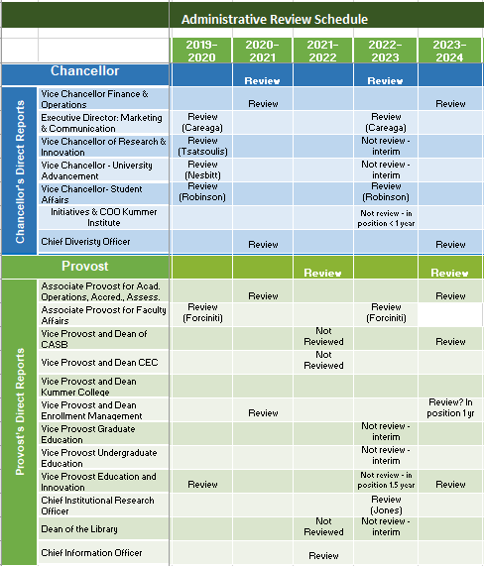
Administrative Review
Schedule
*-Positions not to review
Notes:
Administrative review schedule. 10 positions are possible for review this year, 2022-2023.

Slide 51
Administrative Review Committee
Referral from RP&A:
Chancellor and Provost be reviewed biennially (every other year)
The Administrative Review Committee agreed to this suggestion and therefore changed the recommended schedule to review the Chancellor this year
Notes:
The committee discussed this referral and agreed to it.

Slide 52
Administrative Review Committee
Positions suggested for review
Chancellor
Executive Director: Marketing & Communication
Vice Chancellor – Student Affairs
Associate Provost for Faculty Affairs
Chief Institutional Research Officer
Notes:
The committee discussed and decided the review and not for review lists

Slide 53
Administrative Review Committee
Positions not for review
Vice Chancellor of Research & Innovation: interim
Vice Chancellor – University Advancement: interim
Vice Chancellor – Strat. Initiatives & COO Kummer: <1 yr
Vice Provost Graduate Education: interim
Vice Provost Undergraduate Education: interim
Vice Provost Education & Innovation: 1.5 yr
Dean of the Library: interim

Slide 54
Administrative Review Committee
Tentative timeline and process
Action | Time
Review list to faculty senate for approval | January 26
Job descriptions | January 30
Development of questionnaires
Questionnaires to FS for review/approval | February 16
Statement of accomplishments due | February 24
Review of administrations | March 6 - March 22
Results to FS officers | April 27
Final report to FS | June 1
Notes:
Tentative review schedule.

Slide 55
Agenda
VI. Reports of Standing Committees
E. Budgetary Affairs M. Fitch (for M. Fitch)

Slide 56
Budgetary Affairs Committee
Jan 26, 2023
Referrals
None
Continuing referrals:
Report on the “big picture balance sheet”
Current and next FY budget
Non-referrals
Salary increases/raises

Slide 57
Budget
Current FY budget
Financial aid (discount) better than expected, not all of $1 million contingency gone, but concern over grad student loss at end of CY
Next year (FY 2024)
State appropriation
7% increase, maybe (Gov)
(We are not state employees in that way, don’t get excited)
Tuition:
Enrollment might rise: +27% freshman applications, admits up 12.2%, deposits down by ~100 but last year KV required deposit before apply
Tuition model change to tiers, designed as net zero change
But inflation may drive tuition increase

Slide 58
General Revenue Budget
 | FY20 | FY 21 | FY 22 | FY 23 (budgeted)
Tuition and Fees | $126,853,439 | $119,477,148 | $119,255,572 | $123,885,664
Scholarship Allowance | (37,842,663) | (36,728,607) | (38,692,747) | (41,287,426)
Discount | 30% | 31% | 32% | 33%
Net Tuition & Fees | $89,010,776 | $83,748,541 | 80,562,825 | 82,598,238
State Appropriation | 43,543,499 | 45,690,941 | 53,026,096 | 55,942,347
Gift Revenues | 385,737 | 493,109 | 441,381 | 347,500
Recovery of F & A | 6,802,499 | 6,496,349 | 7,611,796 | 7,290,000
Endowment & Investment Income | 1,992,727 | 1,891,705 | 3,399,798 | 3,391,902
Sales & Services Income | 1,177,479 | 709,380 | 1,125,303 | 999,930
Other Incomes | 2,872,553 | 2,209,518 | 2,841,403 | 2,067,024
Revenue Contingency | - |  | - | -
Total Revenues | $145,785,270 | $140,239,544 | $149,008,602 | $152,636,941
Enrollment: -241 UG, +108 grad
Blank = covers $1 MM tuition shortfall

Slide 59
General Revenue Budget: costs
Total Revenues | $145,785,270 | $140,239,544 | $149,008,602 | $152,636,941
+$3.63 million
Transfers | FY20 | FY 21 | FY 22 (actual*) | FY 23 (budgeted)
Internal | $4,442,960 | $1,988,391 | ($1,097,298) | $1,470,667
Mandatory Transfers | (3,930,896) | (3,483,219) | (3,285,882) | (3,376,171)
NonMandatory Transfers | (6,885,979) | (7,114,077) | (4,445,964) | (3,850,000)
Total Transfers | ($6,373,915) | ($8,630,105) | ($8,829,144) | ($5,755,504)
Expenditures
Salaries & Wages | $80,232,396 | $75,195,068 | $72,970,747 | $80,441,613
Benefit Expense | 25,029,887 | 24,209,899 | 23,542,539 | 27,358,459
Compensation | $105,262,283 | $99,404,966 | $96,513,286 | $107,800,0030
Other Expenses | 33,203,896 | 32,471,617 | 35,350,345 | 39,0449,616
Total Expenditures | $138,466,179 | $131,876,584 | $131,863,631 | $146,849,689
 |  |  | Increase | $14,986,058
Open:
37 Faculty (+6 from Nov)
82 Staff (-8 or more from Nov)
Was 1.247 M increase:
Maintenance +485k
Utilities +437k
IT (from IT fee) + 26.5k
Insurance, etc. +250k
Summer session + 48k
Enroll. contingency +200k

Slide 60
Raises
“Raise” includes
raise,
merit,
market,
counter-offer, and
temporary pay increase (e.g. Dep’t Chair, almost always lost at end of service)
Excludes:
promotion (Prof $10K, Teach Prof $6K, Assoc Prof $5K, Assoc Teach Prof $3K)
Shift from/to administration (Reardon to VPUS, Borrok iDean, Murray iDean, Glaser VPGE)

Slide 61
Notes and Oddities
Admin = Chancellor and Provost and direct reports, as positions
Exclude retiree continuing pay (e.g. Chancellor’s prof = 1/3 previous)
CEC 10 -> 9 departments, 6 -> 2 interim chairs (Cawlfield, Gao)
CASB 13 -> 11 departments, 4 -> 2 interim chairs (Bruening, Kueny)
Market and merit increases unusual pre-2020, now common (base raise was ‘raise’, remainder was ‘market’ or ‘merit’)
At least four NTT -> TT
Counteroffers dominate high increases

Slide 62
Chancellor positions
Position | AY 22-23 |  | AY 21-22 |  | AY 20-21 |  | AY 19-20
Chancellor | Dehghani | +10% | Dehghani | +15% | Dehghani | +11% | Dehghani | +39%
Provost | Potts | +3.3 | Potts | +41.2 | Roberts | +1.7 | Roberts | +20
VC R | Khayat (i) | +3.4 | Khayat | +18.3 | Tsatsoulis |  | Tsatsoulis | +1.7
VC Adv | Verkamp (i) | -31.3 | Nesbitt | +3.7 | Nesbitt |  | Nesbitt | +1.9
VC F&O | O’Neil | +4.9 | O’Neil | +7.0 | Plain |  | Plain | +1.3
VC SA | Robinson | +3.5 | Robinson | +2.9 | Robinson |  | Robinson | +2.1
VC (KI) | Roberts | +3.0 | Roberts | +100
CDO | Roberson | +105 | Rivera² | -20.6 | Rivera²/Outar | -9.0 | Outar | +23.6
CIO¹ | Koob (i) | -34.4 | Tang | +9.4 | Bookout | +9.4 | Bookout | -7.4
aVC | Careaga | +3.6 | Careaga | +15 | Careaga | +16.1 | Careaga | +3.7
SUM | $2,521,112 | +5.5 | $2,390,181 | +29.9 | $1,840,622 | +3.0 | $1,786,828 | +9.0
¹CIO changed to Provost’s report, so excluded from $
²Not official title; official title Director II

Slide 63
Provost positions
Position | AY 22-23 (13) |  | AY 21-22 (12) |  | AY 20-21 (11) |  | AY 19-20 (11)
Provost | Potts | +3.4 | Potts | +41.2 | Roberts (i) | +1.7 | Roberts (i)
CEC Dean | Borrok (i) | -27.3 | Wlezien | 0.0 | Wlezien | 0.0 | Wlezien
CASE Dean | Boroujerdi | +36.8 | Drowne (i) | +0.5 | Drowne (i) | 0.0 | Drowne (i)
KC Dean | Murray (i) | +100
Dep Prov^{a,b} | Brow | +0.2 | Brow | +0.9 | Brow | +2.6 | Brow
VP Enroll | Spivey | -27.3 | Sivadasan | +2.1 | Sivadasan | 0.0 | Sivadasan
VP US | Reardon | -21.5 | Northcut | +1.6 | Northcut (i) | 0.0 | Northcut (i)
VP Ed Inno | Concepcion | +3.9 | Concepcion | +100
VP GE | Glaser | -43.6 | Tsatsoulis | +100
VP Int’l Af |  | -100 | Hofer | +0.6 | Hofer | 0.0 | Hofer
AVC (CIRO) | Jones | +8.3 | Jones | 0.0 | Jones | 0.0 | Jones
AP Admin |  |  |  | -100 | Moore | 0.0 | Moore
AP Fac Af^{a,b} | Forciniti | +5.3 | Forciniti | +1.0 | Forciniti | 0.0 | Forciniti
Spec Asst^{a,b} | Drowne | +138 | Stone | +1.2 | Stone | -2.3 | Stone
AP Ac Op^{b} | Raper | +100
SUM | $2,253,819 | +0.16 | $2,250,301 | +20.4 | $1,869,750 | +0.63^{c} | $1,858,075
ª Officially Professor, Deputy Provost -> Special Asst AY 22
^{b}Fractional appointment
^{c}Summer 10% cut artifact

Slide 64
Department Chairs
AY 22-23 [5.2% vs 4% avg] for 10 continuing
-1.10, 1.50, 2.50, 3.31, 3.50, 6.07, 8.27, 8.66, 9.32, 9.57
AY 21-22 [2.2% vs 3% avg] for 11 continuing
1.32, 1.50, 1.50. 1.51, 1.52, 1.59, 1.78, 2.21, 2.55, 2.63, 6.11
AY 20-21 [-0.2% avg] no increases except Kwame to Professor
Ignores 11 chairperson changes since Sept 2021 (Chem, Econ, Math, Comp Sci, ECE, MAE, MinE, MSE, NERdS, BIT, EMgt)
Ignores ROTC commanders, not S&T funded

Slide 65
Faculty*
*Did not include Lecturers, Research NTT, Chancellor’s profs, or most administrators in numbers
AY 2021-2022
Most dept’s had two raise groupings = 2-4 %, 6-10% (merit, etc.): ECE, EMSE, MSE, MNE, NERdS, TEC, Math
Or lower ~0-3%, 5-10%: ChE, CArE, CS, GGPE, Physics, Hist, ETC
No grouping discerned: MAE, Psych, Bio Sci
3.0%, 7-10%: Chem, BIT, ALP
Faculty range wide (several charts)
AY 2021-2022
Dep’ts varied, 1.13 – 5.74% raise, two groupings = 2.0-2.6 % and 3.3-3.5%
Faculty range wide (several charts)
AY 2020-2021:
0% raise, few merit, several promotions, eight non-zero cases
AY 2019-2020
Dep’ts varied, instructed to use 1.5% for all, then 0.5% to top quarter, dominant model was 1-1.5% for many, 3-6% for the rest
Arithmetic of 3 + 1%, if six faculty each $100/yr, $24 raise pool:
a, b, c, d get $2, $2.5, $3, $3.5 (= $11)
e gets $6
f gets $7

Slide 66
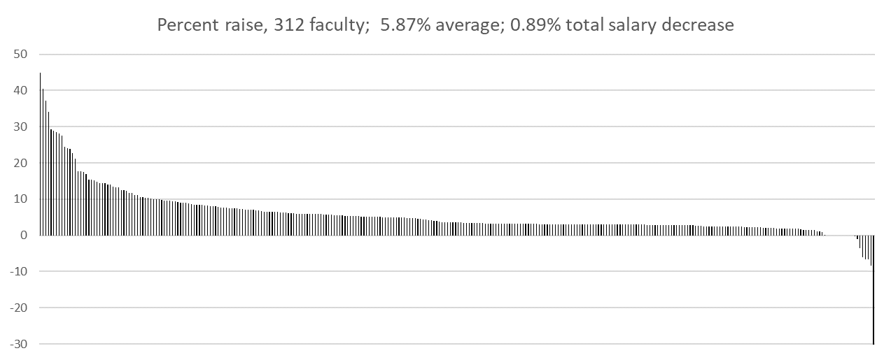
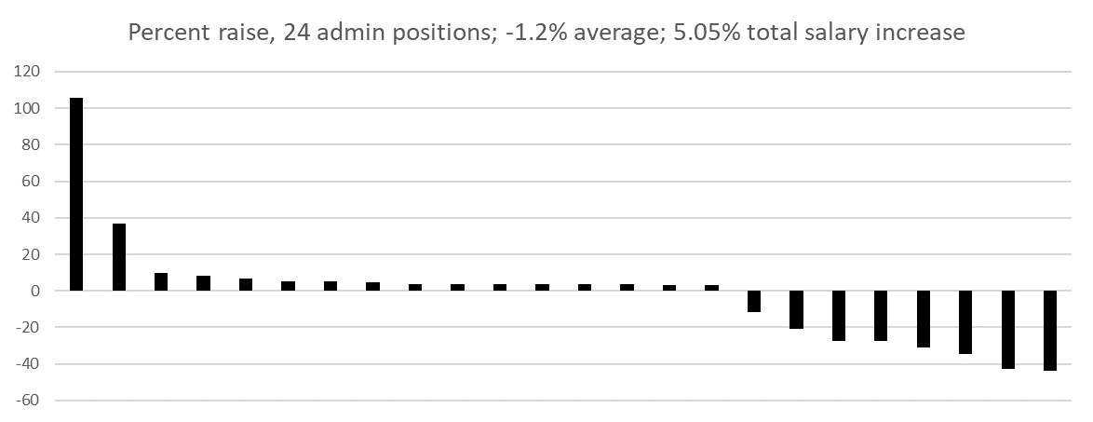
Each bar is one person
>15% are counteroffers and admin
(except one person)
Added VP&D KC
Added AVC IEC
Added AP AOAA
Deleted AVP IA
Deleted DepP (to SpAsst)
*
*
*
*
*
*
*
*
*
*
* Change in person

Slide 67
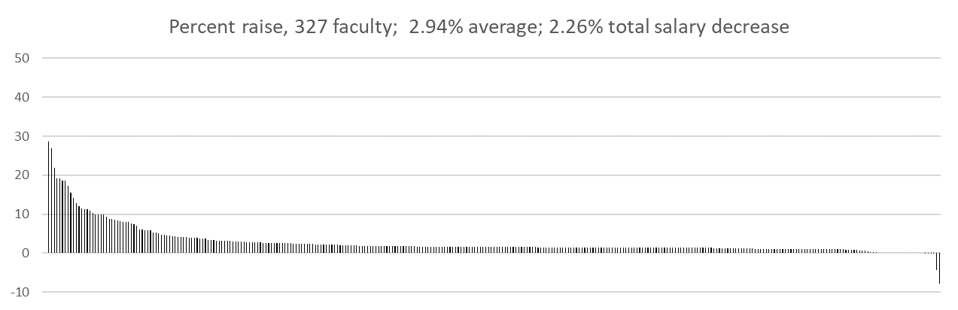
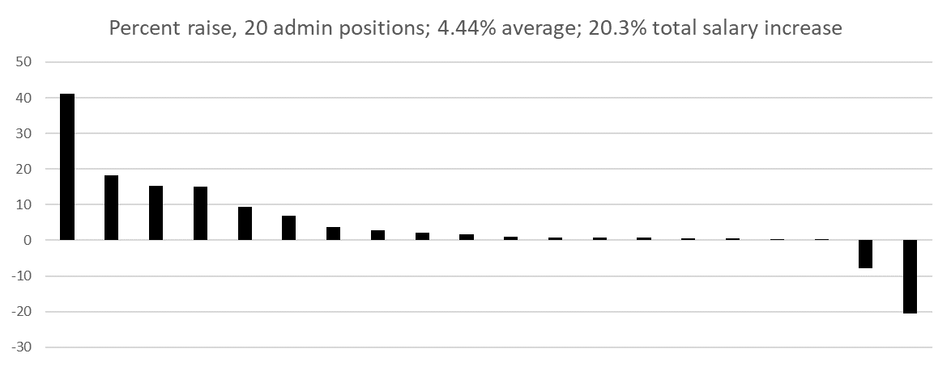
Last year

Slide 68
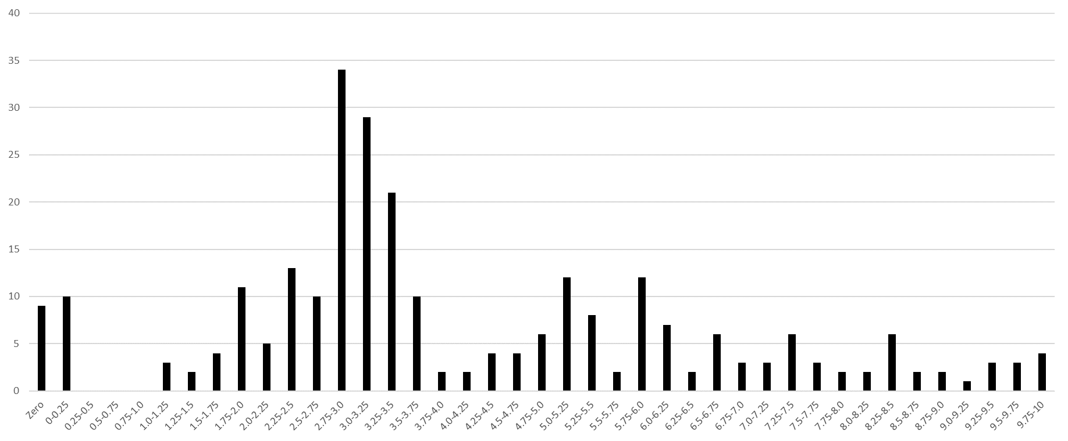
Faculty number per ¼ percent bin
42 faculty members above 10% not shown, influenced by counter-offer (8), TPI/add’l duties (15), or equity (3), and three converted from NTT
2.0% or less,
39 faculty
2.0% - 4.0%,
124 faculty
4% or more,
149 faculty
To increase salary:
Become an administrator
Get an offer somewhere else
Merit it
42
3% ‘raise’
1% ‘merit’

Slide 69
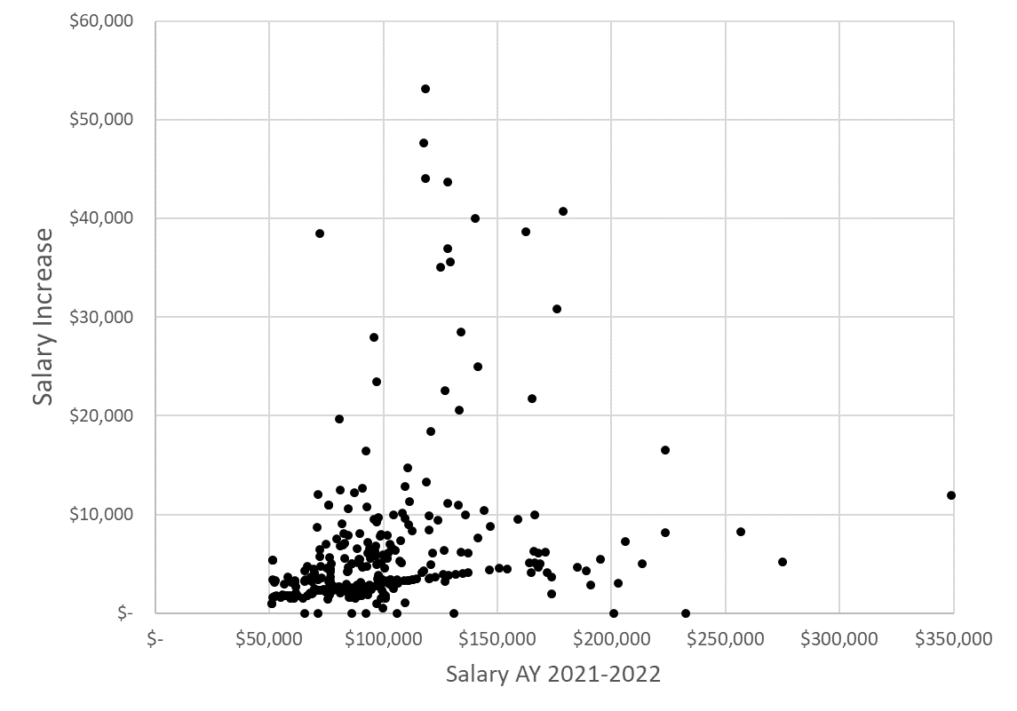
Increase in $ compared to AY 21-22 salary
Excludes promotion $
↑
iDean +$40k, TPI +72k 1/23
↑
iDean +$83k
List of Symbols
Ad = Administrative appointment
Ch = Appointed chair
TPI = Temporary Pay Increase
CO = Counteroffer
AD = Additional duties
CO
Ad, TPI 10k
Ch, TPI 10k
CO
Ad, AD
Ad
CO
Ch
Ch
Ch
CO
Ch
TPI 6k
TPI 14k
TPI 20k
CO
TPI 31k
5.87% (average %)
TPI 13k
CO
4%
[Add’l duties +$100k]→

Slide 70
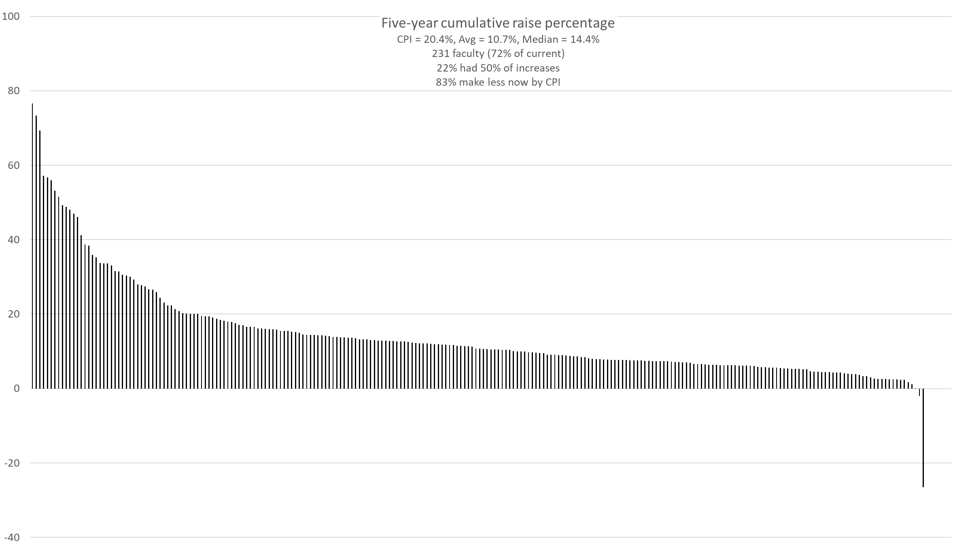
CPI

Slide 71
AY 21-22
*Did not include Lecturers, Research NTT, Chancellor’s profs, or administrators in numbers
Department
Psych
Engl &TC
Bio Sci
Math
Econ
MAE
CArE
EMSE
MSE
NucE
ALP
CS
TEC
ChE
0
1
2
ECE
3
4
5
6
Physics
Chem
GGPE
MinE
Hist & PS
BIT
Econ 1.29 CS 3.14
Engl & TC 2.01 GGPE 3.25
Physics 2.04 EMSE 3.34
MAE 2.16 Hist & PS 3.39
Chem 2.38 BIT 3.40
CArE 2.41 Math 3.41
ECE 2.48 TEC 3.54
Psych 2.50 MSE 3.98
Bio Sci 2.57 Che 5.51
MinE 2.57 NucE 5.74
ALP 2.61
ChE 3.0% w/o counter offer
NucE 4.6% w/o aTP to aP
MSE 3.3% w/o counter offer

Slide 72
AY 22-23
*Did not include Lecturers, Research NTT, Chancellor’s profs, or administrators in numbers
Department
MAE
Engl &TC
GGPE
Econ
Chem
Bio Sci
Math
EMSE
Psych
CArE
ALP
CS
0
1
2
3
4
5
ChE
6
7
8
ECE
BIT
MSE
NERdS
MinE
TEC
Hist & PS
Econ 2.58 MSE 5.94
ALP 4 Math 6.14
Chem 4.29 NERdS 6.39
BIT 4.99 EMSE 7.1
MAE 5.03 MinE 7.15
Hist & PS 5.09 CS 7.4
Bio Sci 5.1 Psych 7.92
Physics 5.26 GGPE 8.11
TEC 5.26 CArE 8.15
ChE 5.26 ECE 8.18
Engl & TC 5.27
Physics

Slide 73
AY 22-23 Sum of Salaries Change %
*Did not include Lecturers, Research NTT, Chancellor’s profs, or most administrators in numbers
Department
NERdS
Chem
Hist & PS
MSE
GGPE
Math
CArE
CS
EMSE
ChE
MAE
BIT
-20
-15
-10
-5
0
5
ECE
+10
+15
+20
Econ
MinE
ALP
Psych
TEC
Bio Sci
Physics
Engl &TC
Faculty Count
CS -6 Engl & TC 0
Hist & PS -2 CArE 0
ALP -2 TEC 0
MSE -1 ChE -1
Econ -1 ECE 0
Psych -1 MAE 0
EMSE -1 Bio Sci +1
Physics -2 BIT +1
GGPE -2 MinE +1
Math -1 NERdS +1
Chem 0
CS -24.8 Engl & TC 4.7
Hist & PS -12.3 CArE 4.9
ALP -5.1 TEC 5.4
MSE -4.9 ChE 5.5
Econ -4.6 ECE 8.4
Psych -2.7 MAE 9.4
EMSE -2.5 Bio Sci 12.4
Physics -0.1 BIT 12.6
GGPE 1.1 MinE 16.8
Math 3.1 NERdS 31.2
Chem 4.2

Slide 74
Faculty*
*Did not include Lecturers, Research NTT, Chancellor’s profs, or administrators in numbers
Dept | ALP | Bio | BIT | Chm | ChE | CArE | CS¹ | Econ | ECE | EMSE | Engl | GPE | Hist | Math | MSE | MAE | MNE | NE² | Phys | Psych | TEC
Net | -6 | +3 | -3 | -8 | -5 | -2 | +3 | -3 | -5 | -3 | +1 | -5 | 0 | -4 | -3 | -7 | 0 | -1 | -3 | -1 | +2
’18 | 20 | 11 | 18 | 24 | 16 | 28 | 16 | 9 | 36 | 16 | 18 | 22 | 13 | 24 | 20 | 40 | 9 | 8 | 19 | 12 | 2
’19 | 18 | 10 | 17 | 21 | 15 | 29 | 17 | 7 | 34 | 17 | 18 | 22 | 13 | 22 | 19 | 33 | 9 | 9 | 16 | 11 | 3
‘20 | 16 | 11 | 16 | 18 | 15 | 29 | 20 | 7 | 32 | 15 | 17 | 20 | 13 | 21 | 18 | 34 | 8 | 6 | 16 | 12 | 4
’21 | 16 | 13 | 14 | 16 | 12 | 26 | 19 | 7 | 31 | 14 | 19 | 19 | 13 | 20 | 18 | 33 | 8 | 6 | 17 | 12 | 4
‘22 | 14 | 14 | 15 | 16 | 11 | 26 | 13 | 6 | 31 | 13 | 19 | 17 | 11 | 19 | 17 | 33 | 9 | 7 | 15 | 11 | 4
¹Frimpong in MNE, Gao in GGPE
²Newkirk from MSE to NERdS
-15 faculty from last year = -4.5%; FTE Students -62 = -1%, Executives +2 = +9%
2018-19 AY, 381 faculty, 60 fewer now (-16%)
2019-20 AY, 361 faculty, 40 fewer now (-11%)
Murray,
Faley,
Raper,
-Brow

Slide 75
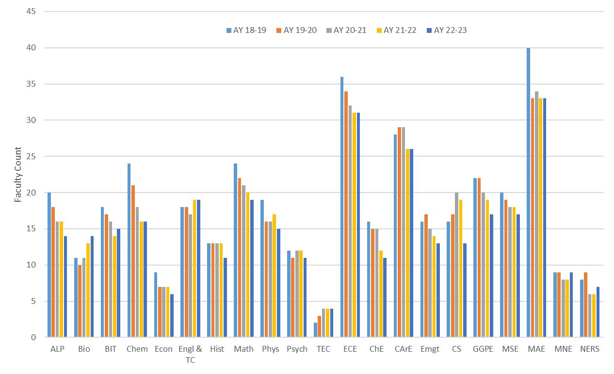
Faculty headcount
381 360 348 337 321 (~4.4% fewer per year)

Slide 76
Agenda
VII. Adjourn
Tell your dogs I said hi!
76

